Slide 1
Lecture 1

Slide 2
Chapter 1
Introduction to Multimedia

Slide 3
1.1 The term “multimedia “.
applications that use multiple modalities, including text, images, drawings (graphics), animation, video, sound including speech, and interactivity.

Slide 4
1.1 Multimedia and Computer Science
Graphics, HCI, visualization, computer vision, data compression, graph theory, networking, database systems --- all have important contributions to make in multimedia at the present time.

Slide 5
Components of Multimedia
Multimedia involves multiple modalities of text, audio, images, drawings, animation, and video.
Examples of how these modalities are put to use:
1. Video teleconferencing.
2. Distributed lectures for higher education.
3. Tele-medicine.

Slide 6
History of Multimedia:
Newspaper: perhaps the first mass communication medium, uses text, graphics, and images.
Motion pictures: conceived of in 1830's in order to observe motion too rapid for perception by the human eye.
Wireless radio transmission: Guglielmo Marconi, at Pontecchio, Italy, in 1895.
Television: the new medium for the 20th century, established video as a commonly available medium and has since changed the world of mass communications.

Slide 7
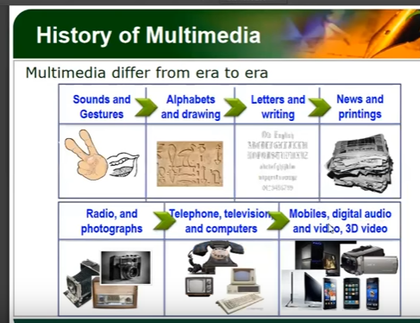

Slide 8
History of Multimedia:
5. The connection between computers and ideas about multimedia covers what is actually only a short period:
1945 - Vannevar Bush wrote a landmark article describing what amounts to a hypermedia system called Memex.
1960 -Ted Nelson coined the term hypertext.
2000 - WWW size was estimated at over 1 billion pages.

Slide 9
Hypermedia
A hypertext system: meant to be read nonlinearly, by following links that point to other parts of the document, or to other documents
HyperMedia: not constrained to be text-based, can include other media, e.g., graphics, images, and especially the continuous media sound and video.
The World Wide Web (WWW) | the best example of a hypermedia application.

Slide 10
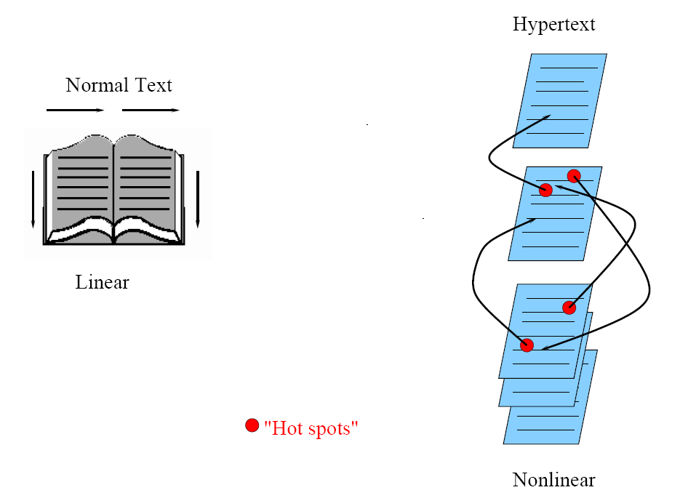
Hypertext is nonlinear

Slide 11
Multimedia
Multimedia means that computer information can be represented through audio, graphics, images, video, and animation in addition to traditional media.

Slide 12
• Examples of typical present multimedia applications include:
– Electronic newspapers/magazines.
– World Wide Web.
– On-line reference works: e.g. encyclopedia, games, etc.
– Interactive TV.
– Video conferencing.
– Video-on-demand.

Slide 13
1.3 World Wide Web
• The W3C has listed the following goals for the WWW:
1. Universal access of web resources (by everyone everywhere).
2. Effectiveness of navigating available information.
3. Responsible use of posted material.
• History of the WWW
1960s – Charles Goldfarb et al. developed the Generalized Markup Language (GML) for IBM.
1986 – The ISO released a final version of the Standard Generalized Markup Language (SGML).

Slide 14
1990 – Tim Berners-Lee invented the HyperText Markup Language (HTML), and the HyperText Transfer Protocol (HTTP).
1993 – NCSA released an alpha version of Mosaic based on the version by Marc Andreessen for X-Windows — the first popular browser.
1994 – Marc Andreessen et al. formed Mosaic Communications Corporation — later the Netscape Communications Corporation.
1998 – The W3C accepted XML version 1.0 specifications as a Recommendation — the main focus of the W3C and supersedes HTML.

Slide 15
HTTP (HyperText Transfer Protocol)
• HTTP: a protocol that was originally designed for transmitting hypermedia, also support the transmission of any file type.
• HTTP is a request/response protocol.

Slide 16
HTML (HyperText Markup Language)
• HTML: a language for publishing Hypermedia on the World
Wide Web.
1. HTML uses ASCII, it is portable to all different (possibly
binary incompatible) computer hardware.
2. The current version of HTML is version 4.01.
3. The next generation of HTML is XHTML — a reformulation of HTML using XML.
• HTML uses tags to describe document elements:
– < > — defining a starting point.
– </ > — the ending point of the element.

Slide 17
A simple HTML page:
<HTML> <HEAD>
<TITLE>
A sample web page.
</TITLE>
<META NAME = "Author" CONTENT = "Cranky Professor">
</HEAD> <BODY>
<P>
We can put any text we like here, since this is a paragraph element.
</P>
</BODY> </HTML>

Slide 18
XML (Extensible Markup Language)
• XML: a markup language for the WWW in which there is modularity of data, structure and view so that user or application can be able to define the tags (structure).
• Example of using XML to retrieve stock information from a database by a user query.

Slide 19
SMIL (Synchronized Multimedia Integration Language)
SMIL: a particular application of XML that allows for specification of interaction among any media types and user input, in a temporally scripted manner.

Slide 20
Multimedia Software Tools
for carrying out tasks in multimedia are:
1. Music Sequencing and Notation
2. Digital Audio
3. Graphics and Image Editing
4. Video Editing
5. Animation
6. Multimedia Authoring

Slide 21
1.Music Sequencing and Notation
Cakewalk Pro Audio.
- The term sequencer comes from older devices that stored sequences of notes ("events", in MIDI [Musical Instrument Digital Interface]).
It is also possible to insert WAV files and Windows commands (for animation and video) into music tracks.

Slide 22
2.Digital Audio
tools deal with accessing and editing the actual sampled sounds that make up audio:
Adobe Audition (formerly Cool Edit) is a powerful, popular digital audio toolkit that emulate a professional audio studio, including multitrack productions and sound file editing, along with digital signal processing effects.
Sound Forge Like Audition, Sound Forge is a sophisticated PC-based program for editing WAV files.

Slide 23
3. Graphics and Image Editing
Adobe Illustrator: a powerful publishing tool from Adobe. Uses vector graphics; graphics can be exported to Web.
Adobe Photoshop: the standard in a graphics, image processing and manipulation tool.
Allows layers of images, graphics, and text that can be separately manipulated for maximum flexibility.
Filter factory permits creation of sophisticated lighting-effects filters
Adobe Fireworks: software for making graphics specifically for the web.

Slide 24
4. Video Editing
Adobe Premiere: an intuitive, simple video editing tool for nonlinear editing, i.e., putting video clips into any order:
- Video and audio are arranged in "tracks".
A large library of built-in transitions, filters and motions for clips => effective multimedia productions with little effort.
Adobe After Effects: a powerful video editing tool that enables users to add and change existing movies. Can add many effects: lighting, shadows, motion blurring; layers.

Slide 25
5. Animation
Multimedia APIs:
Java3D: API used by Java to construct and render 3D graphics, similar to the way in which the Java Media Framework is used for handling media files.
DirectX : Windows API that supports video, images, audio and 3-D animation

Slide 26
6. Multimedia Authoring
Tools that provide the capability for creating a complete multimedia presentation, including interactive user control, are called authoring programs.
Macromedia Flash: allows users to create interactive movies by using the score metaphor, i.e., a timeline arranged in parallel event sequences.
Macromedia Director: uses a movie metaphor to create interactive presentations. It is very powerful and includes a built in scripting language, Lingo, that allows creation of complex interactive movies.

